Slide 1

What are we going to see in this session?
What is Git ?
Overview about version control system
History of Git
Advantage of using Git
Types of version control system

Slide 2
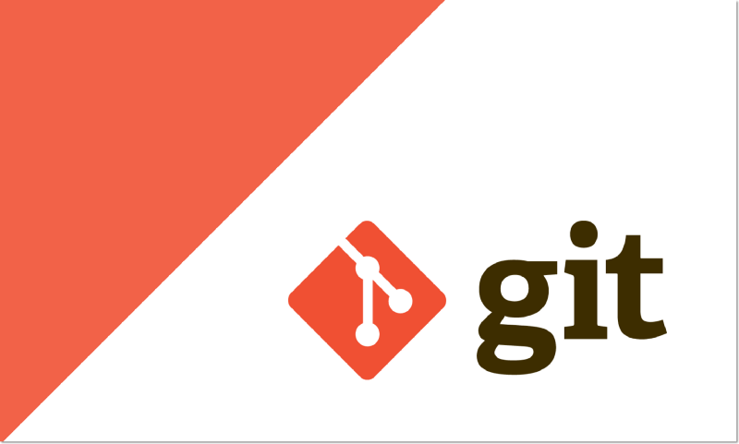
What is Git ?
Git is an distributed version control (source control) system.
What is version control by the way ?
System that records changes of your file/project and then able to recall any specific version of project at later point in time.
In other words – version control mechanism allows us to go back in time and get previous state of your project, also you can compare the changes over time.

Slide 3



Problem without version control.
Lets assume you are working on web-page creation project.
You have done couple of things like creating [Header & footer etc for your web-page]
You are going to save this contents into folder as an first version.
For every new change in web-page, you might create new folder.
Project – v1.0
Project – v2.0
Project – v3.0
This approach would fill up your drive easily, when the project file grows exponentially.

Slide 4
Version control as an solution.
In order to avoid such painful and complexity in handling files for bigger projects version control system was created.
Version control system allows you to make snapshot of current state of your project.
Which means all of your different versions of project is going to be saved in one directory.
Project – v1.0/v2.0/v3.0

Slide 5
History of Git..
Now you might be clear about version control system.
Git is one of the version control tool like any other.
Other version control system tools available in market are..
Subversion
Beanstalk
Mercurial
Perforce
Git is created by “Linux Torvalds” The same person who created the Linux kernel.
As like Linux, Git is also an open source tool.

Slide 6
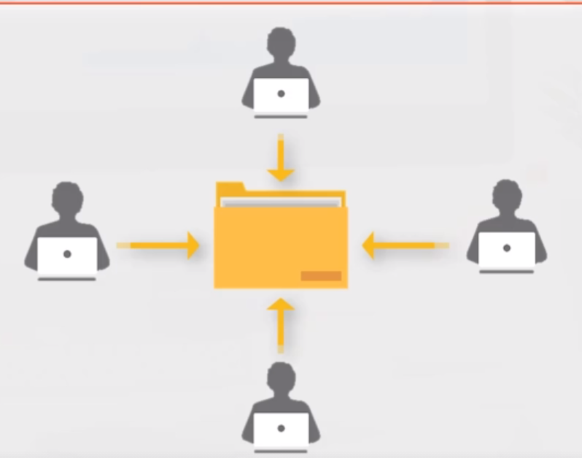
Advantage of using Git ?
Collaboration. (Different developers can work on the same project)
For this use some solutions such as
GitHub
GitLab
Bitbucket
This solutions just provide some shareable place to store your code using Git.

Slide 7
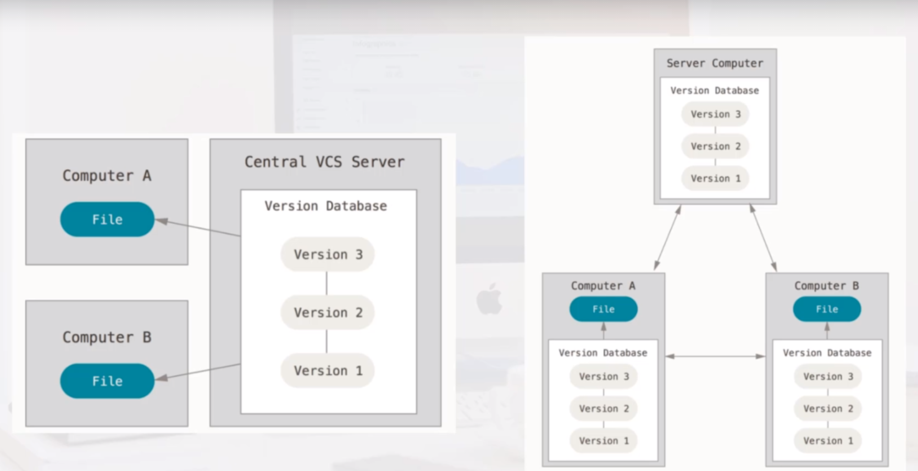
Types of version control system
In General, there are 2 types of version control system.
Centralized :
Downside :
If any network failure
you may not be able to
reach your project files.
If central server collapse
we may loose the project
files.
Distributed :
Versions of project files saved locally, in different computers & git server. Hence it has several copies.

Slide 8
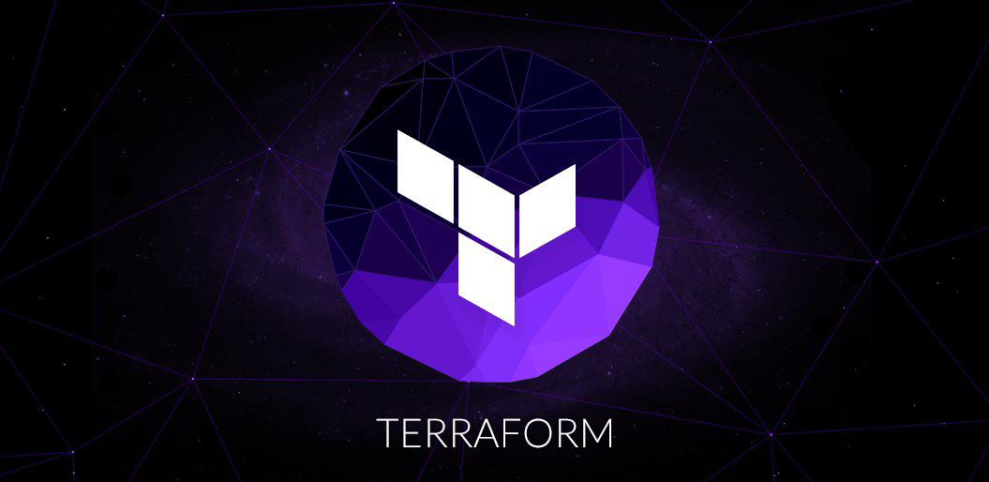
End of this topic !
Any questions?

